Slide 1
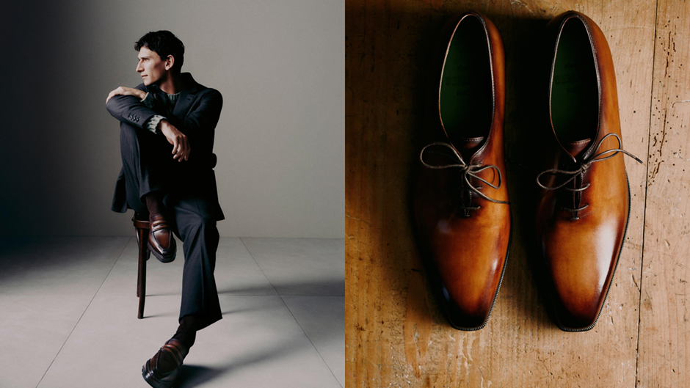
LVMH
WORLD OF LUXURY

Slide 2
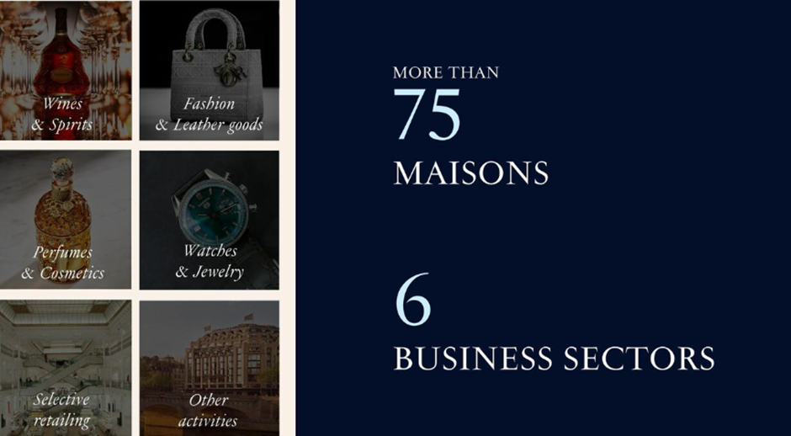
LVMH
The Making
More than 75 Maisons, 6 business sectors, over 213 000 employees across 80 countries, and more than 6,000 stores

Slide 3
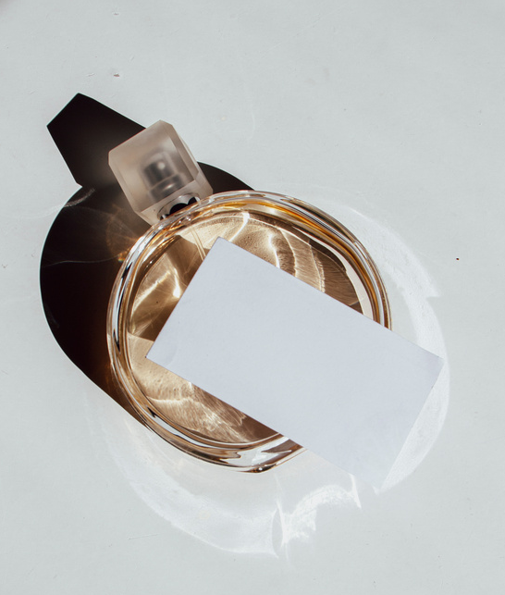
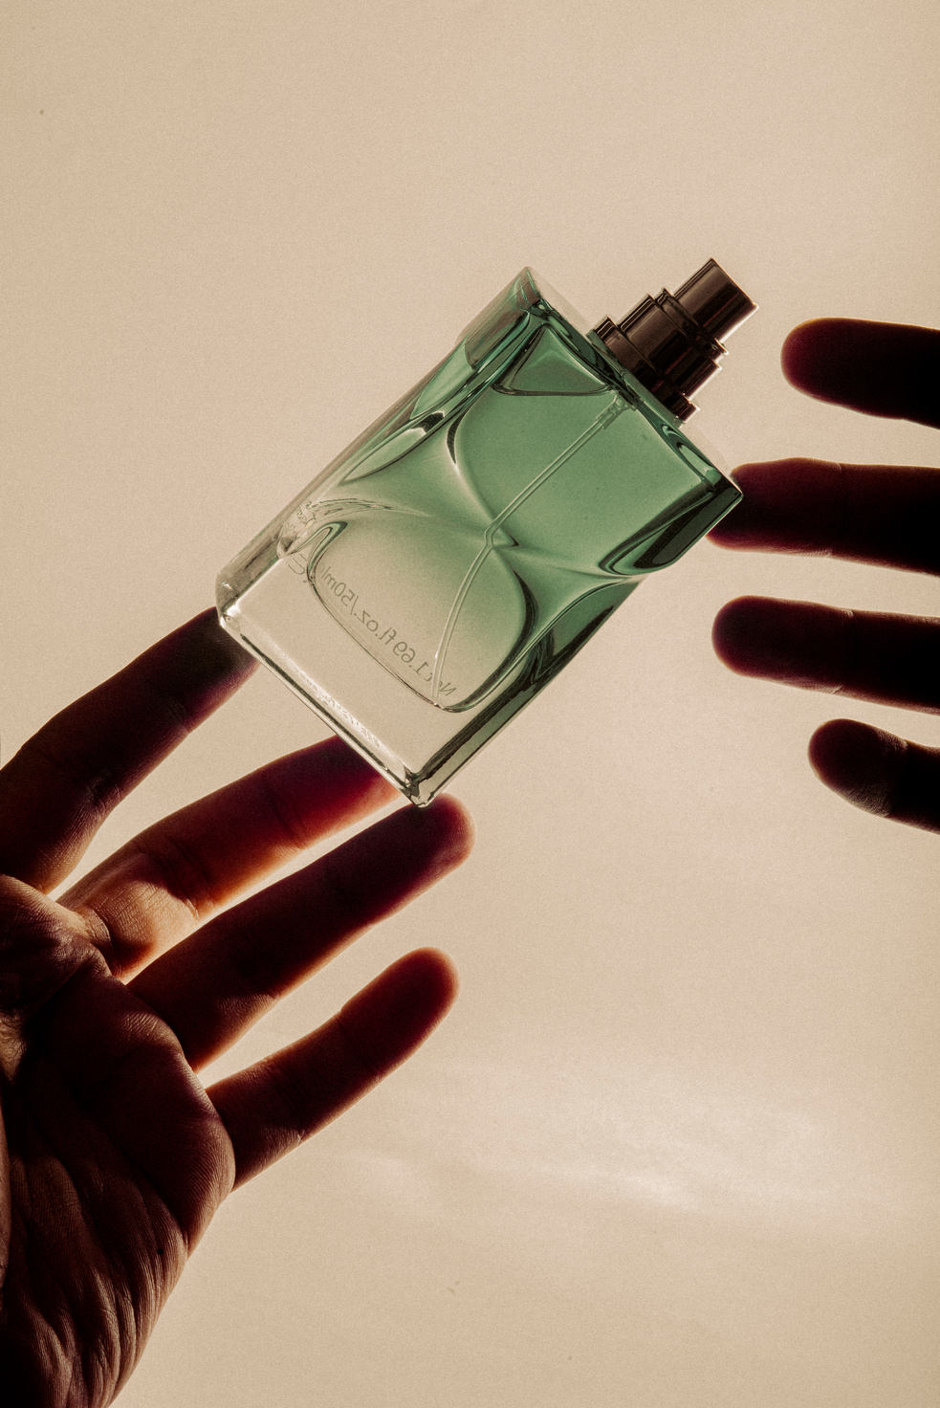
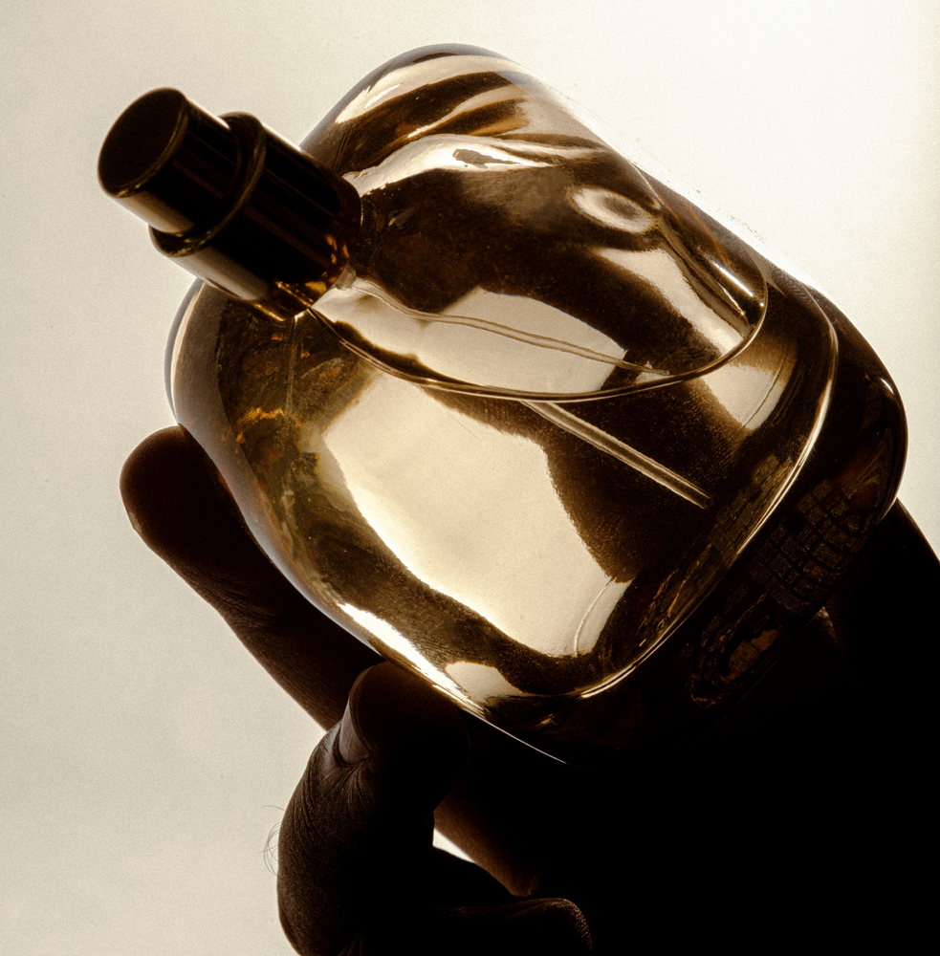
Values of LVMH
BEING CREATIVE AND INNOVATIVE
DELIVERING EXCELLENCE
CULTIVATING AN ENTREPRENEURIAL SPIRIT
BEING COMMITTED TO POSITIVE IMPACT

Slide 4
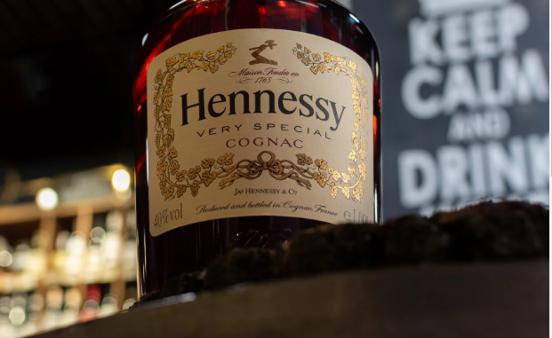
1.FOCUS ON WINES & SPIRITS
STRATEGIC PRIORITIES
Pursue value-enhancing strategy
Expand production capacities to ensure sustainable growth
Develop direct sales to end-customers
Further improve efficiency of distribution in key markets
Accelerate efforts to protect the environment, in particular in supply chains and packaging

Slide 5
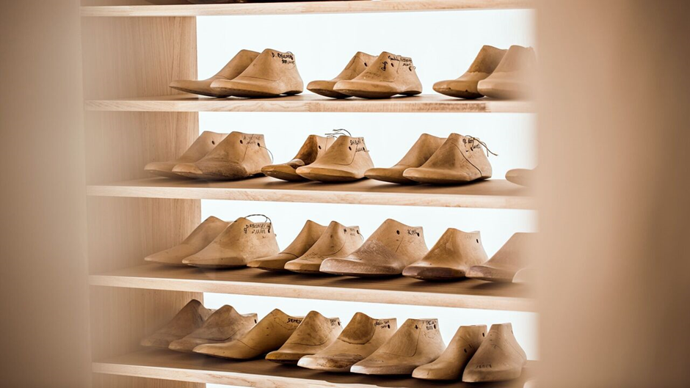
2. FOCUS ON FASHION & LEATHER GOODS
Maison Berluti has become an icon in men’s luxury footwear
Berluti’s appeal is more than just good looks—it’s about attracting attention through quiet confidence and subtle elegance
Berluti’s commitment to craftsmanship and personalization has kept the Maison at the forefront of luxury shoemaking

Slide 6
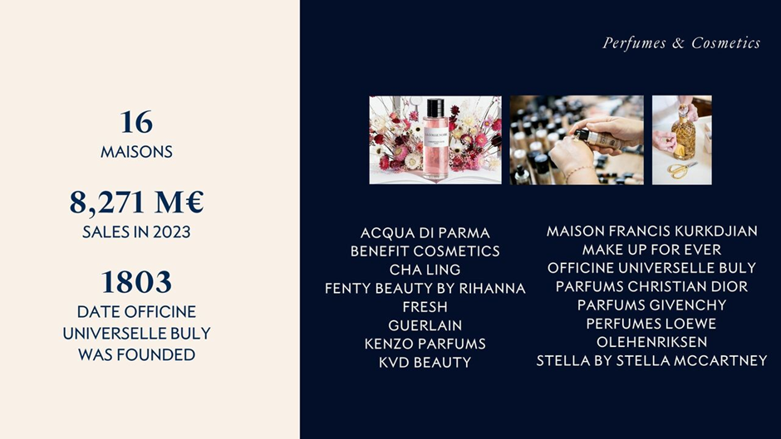
3.FOCUS ON PERFUMES & COSMETICS
The success of the Perfumes & Cosmetics division depends on finding the right balance between major historic Maisons such as Parfums Christian Dior, Parfums Givenchy and Guerlain, and younger brands with strong potential like Benefit Cosmetics, Fresh, Make Up For Ever.
Yet, these brands are driven by the same values:
quest for excellence
creativity
innovation
perfect mastery of their image.

Slide 7
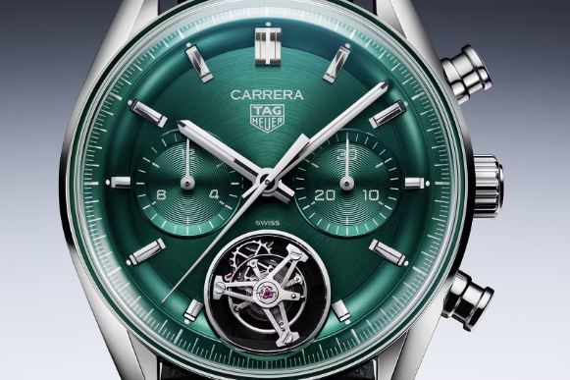
4.FOCUS ON WATCHES & JEWELRY
Maisons in the Watches & Jewelry sector of LVMH operate in two segments: high-quality watchmaking on the one hand, and jewelry and high jewelry on the other.

Slide 8
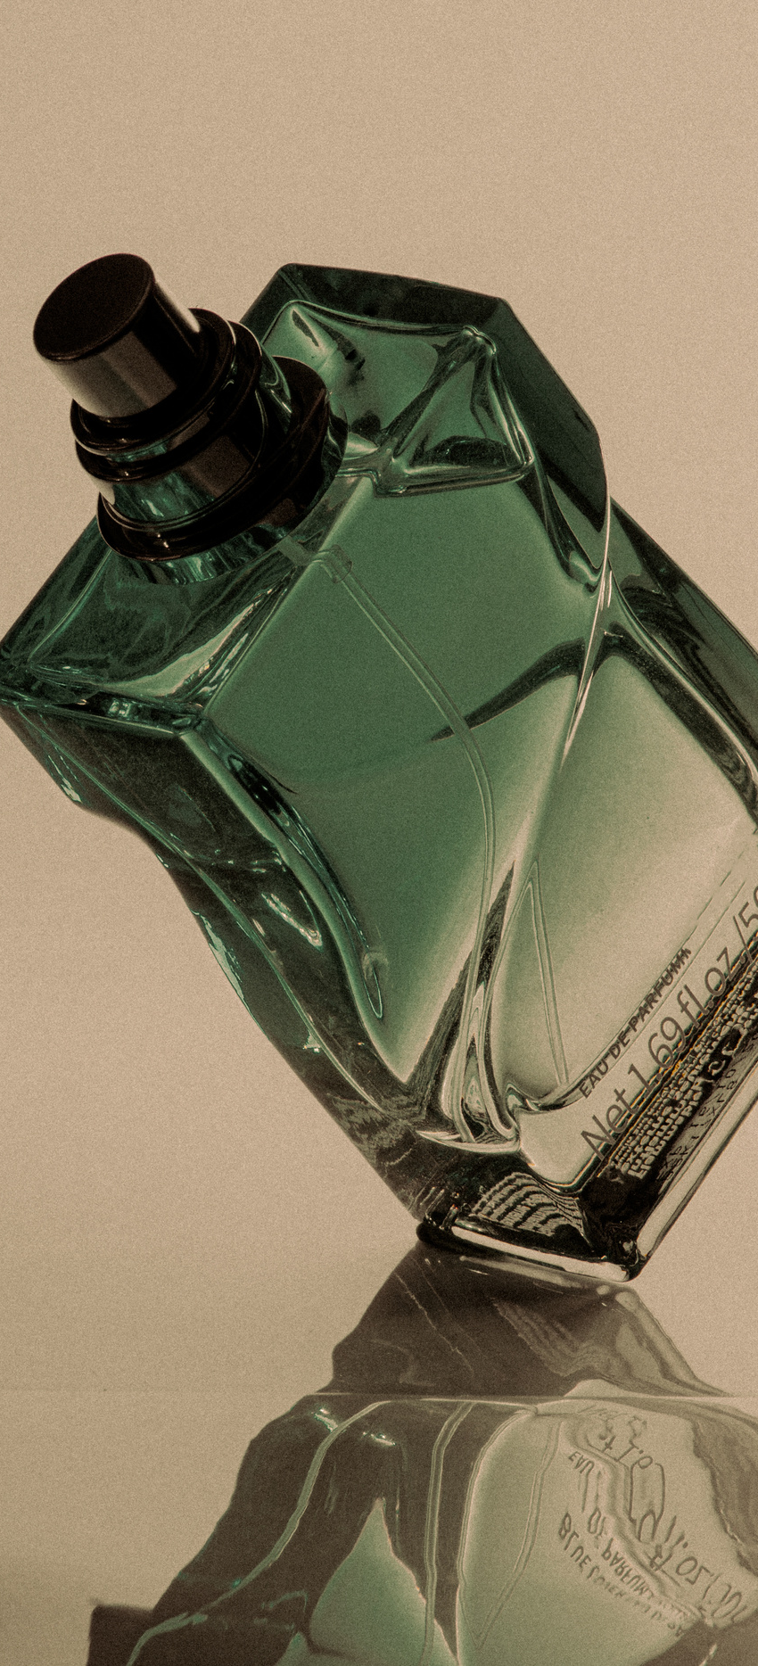
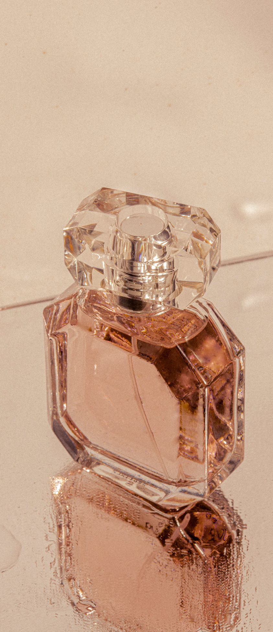
5.FOCUS ON SELECTIVE RETAILING
The Selective Retailing Maisons in the LVMH Group share the same objective:
to transform shopping into a unique experience.
Key drivers of selective retailing:
Specialist product selection,
Upgrading of stores and services,
Constant innovation,
Digitalization
Personalization of relationships

Slide 9
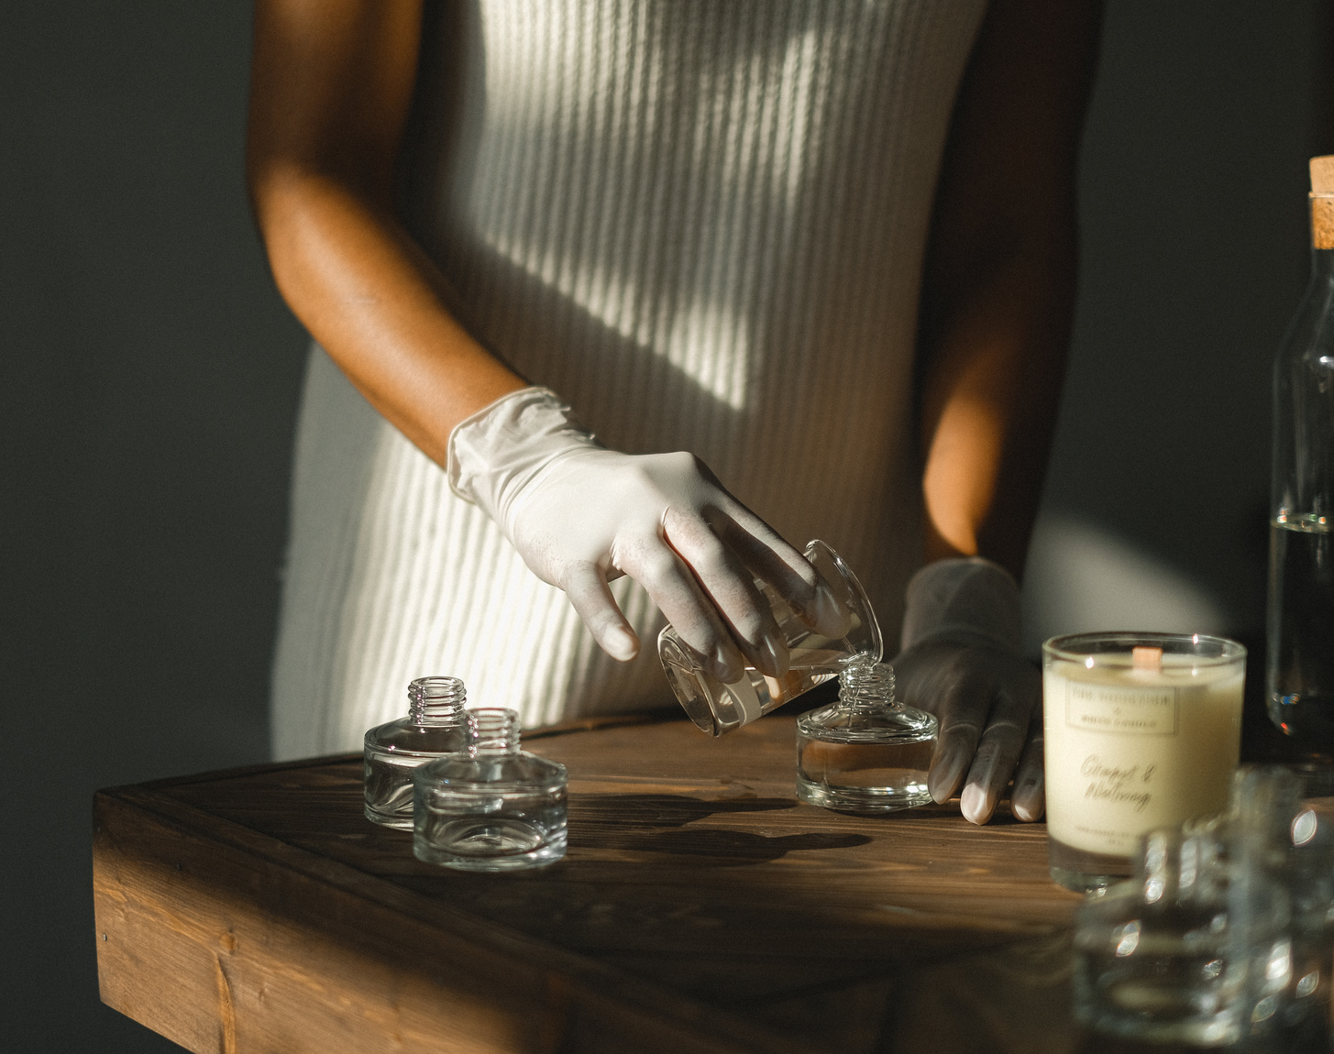
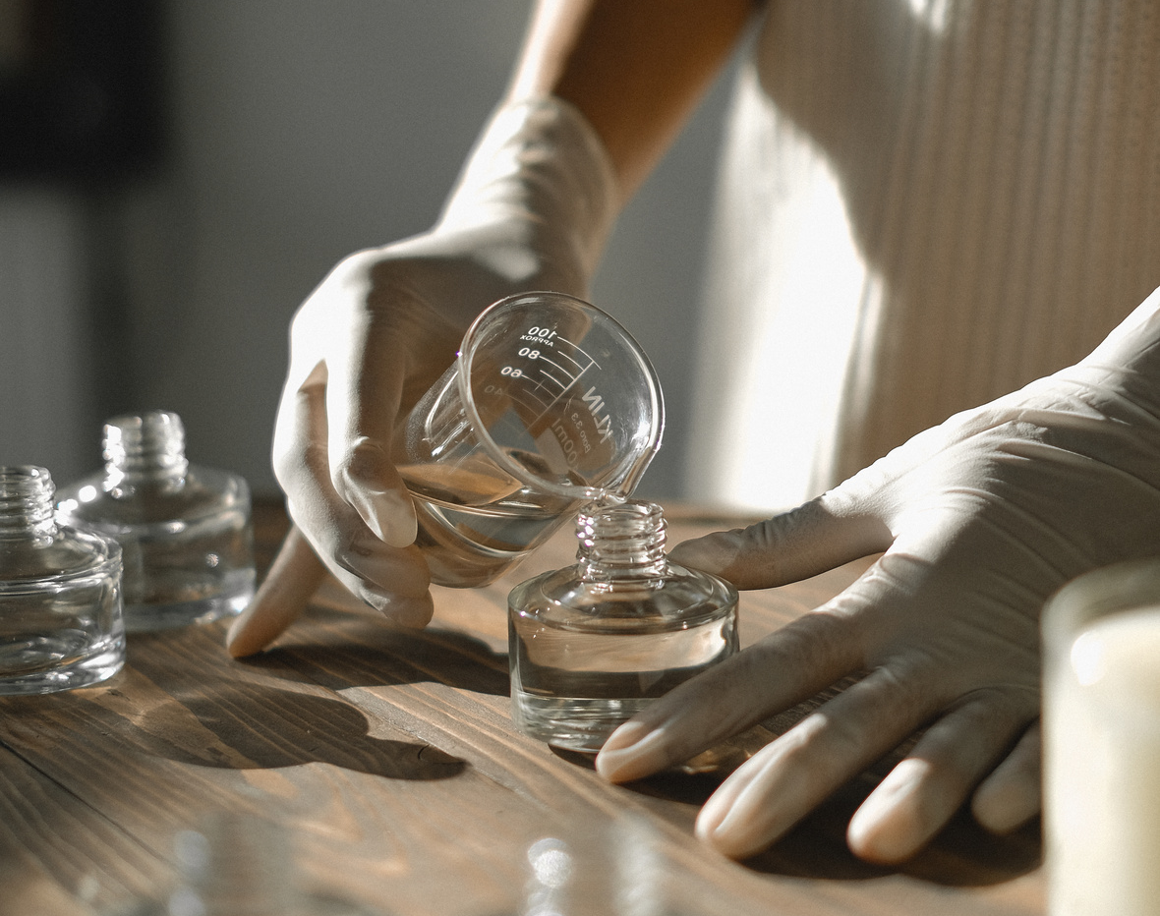
6.FOCUS ON OTHER ACTIVITIES
Craftsmanship meets creativity
Inspired by the spirit of LVMH and its love for contemporary innovation, Cheval Blanc revisits the codes of ultra-Luxury hospitality with bold modernity. .

Slide 10
LVMH
Brand’s Operating Model
BRAND OPERATING MODEL HAS 6 PILLARS DEFINED BY EXCELLENCE & HIGH QUALITY
DECENTRALIZED ORGANIZATION
VERTICAL INTEGRATION
SUSTAINING SAVOIR-FAIRE
ORGANIC GROWTH
CREATING SYNERGIES
BALANCE ACROSS BUSINESS SEGMENTS& GEOGRAPHIES

Slide 11
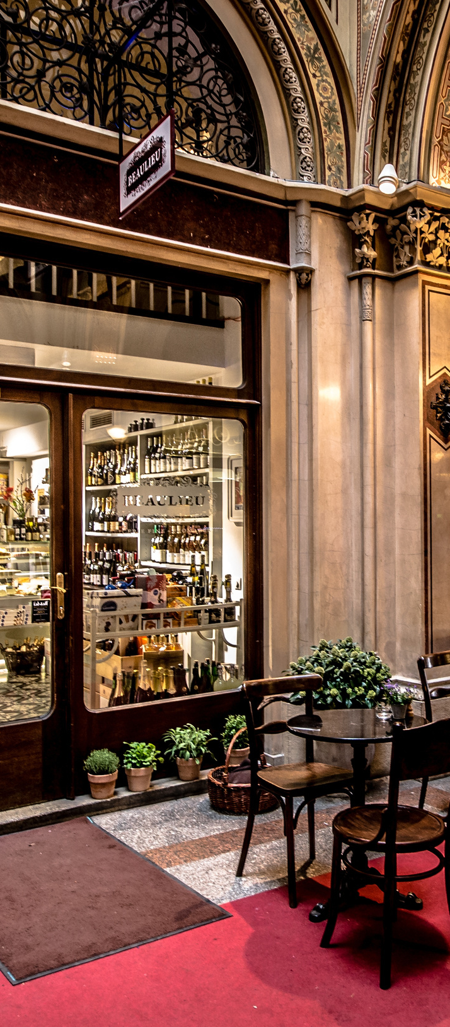
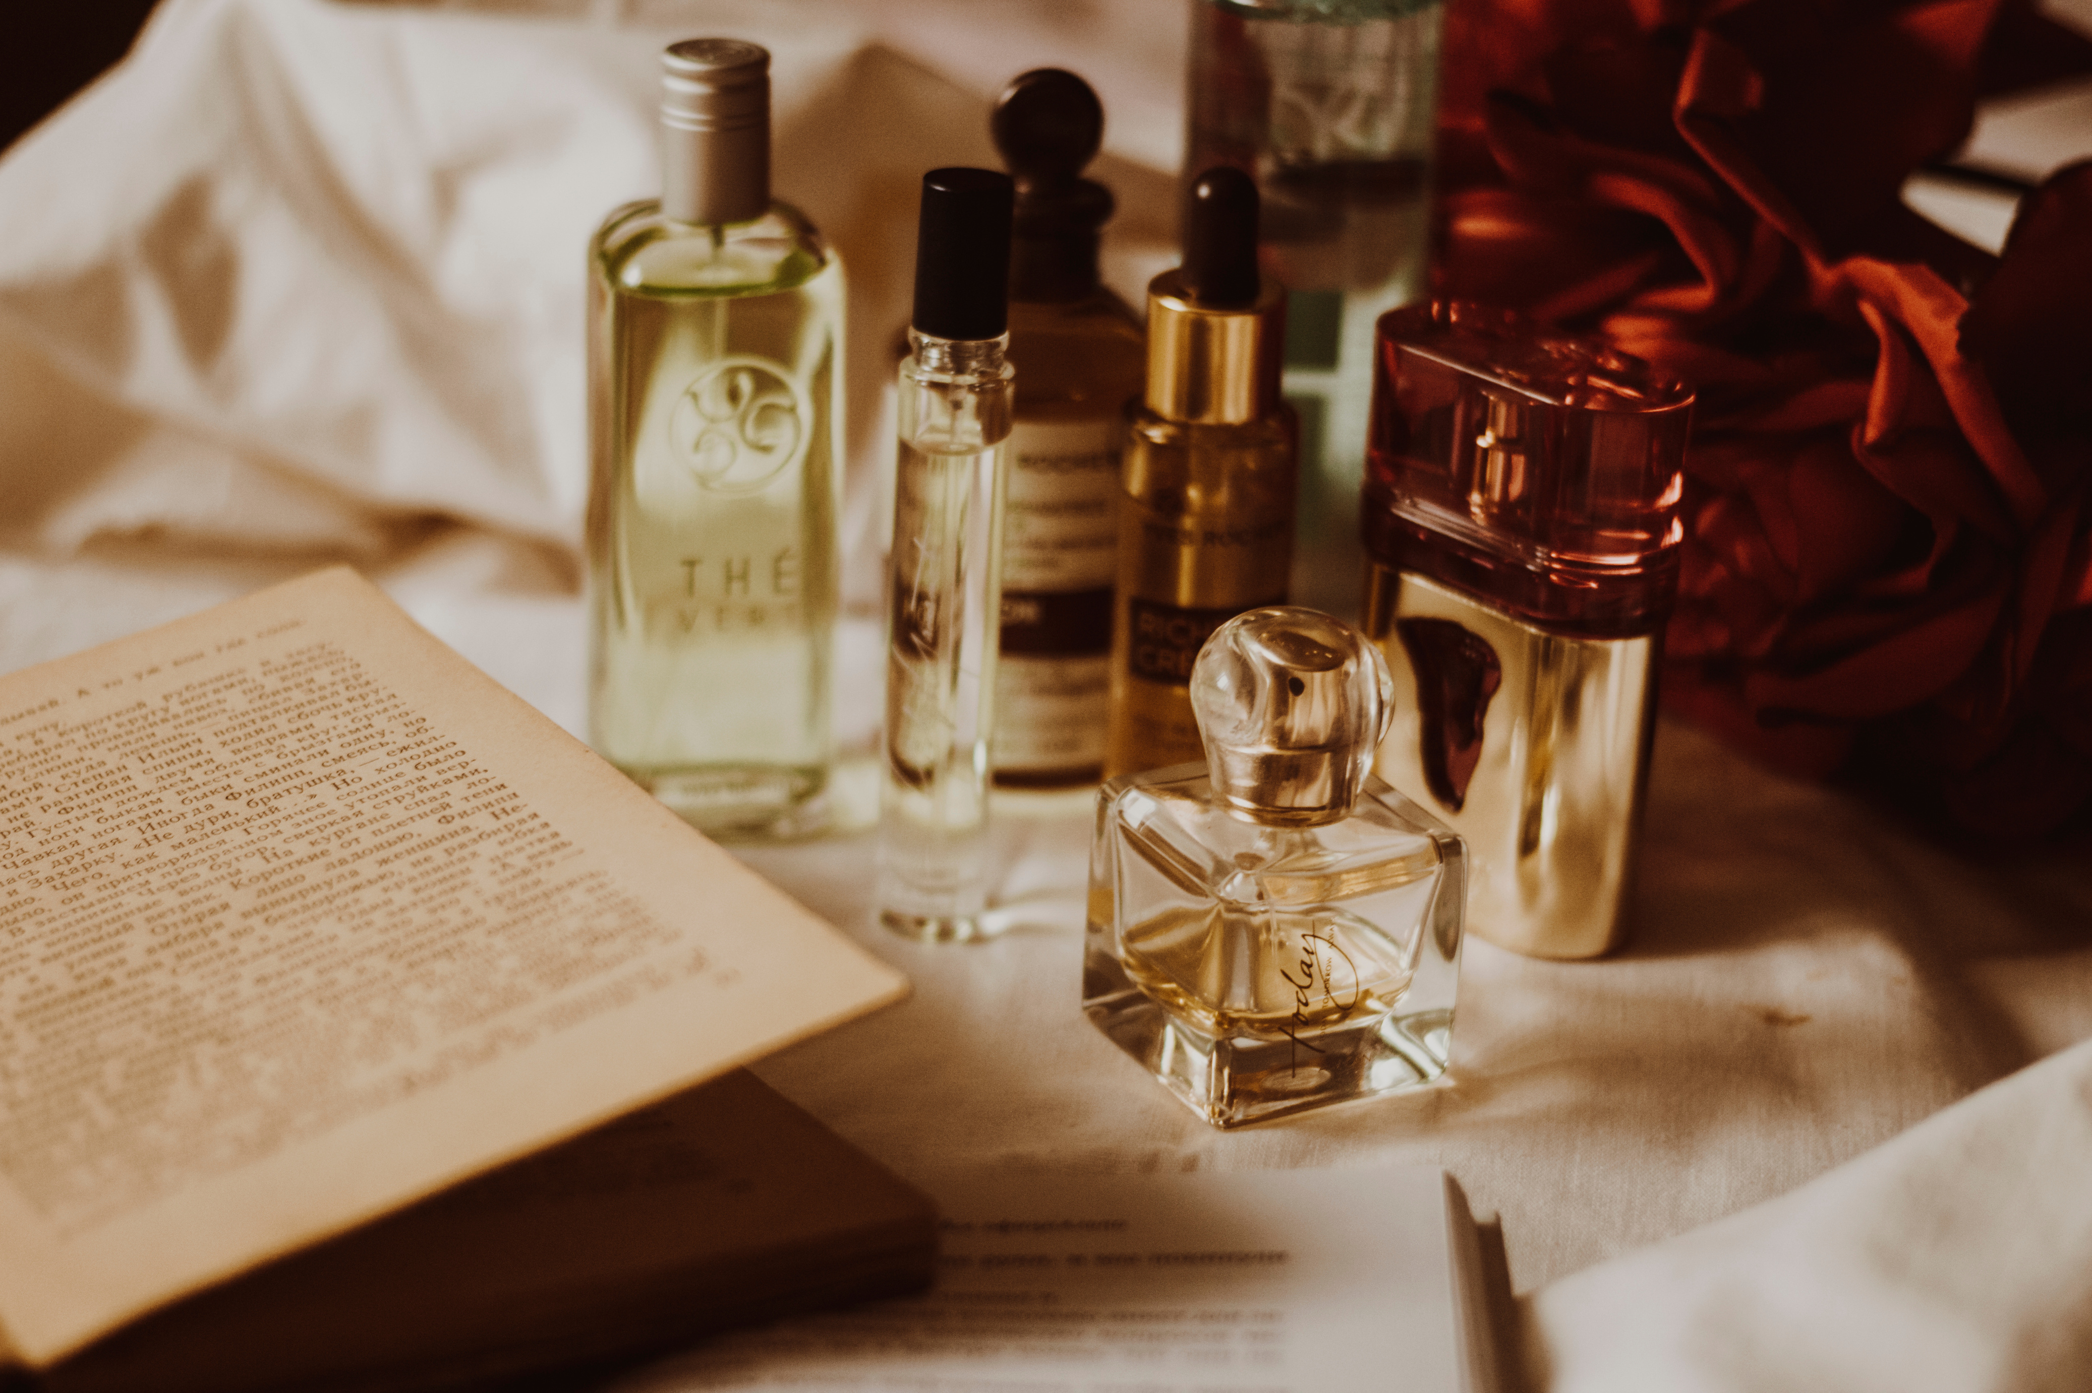
Key Insights
Key Challenges of Luxury Industry
Past, Present,Future:Luxury Formula
Consumer Behaviour & Key Markets
How to define Luxury
Identification as Luxury Product
Personalization in Luxury Industry
SOURCE: LVMH COURSE CERTIFICATION

Slide 12
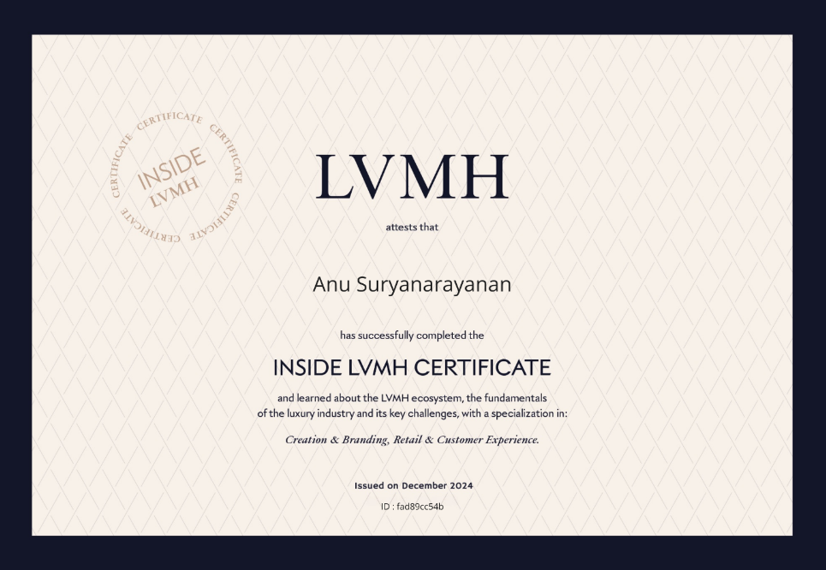

Slide 13
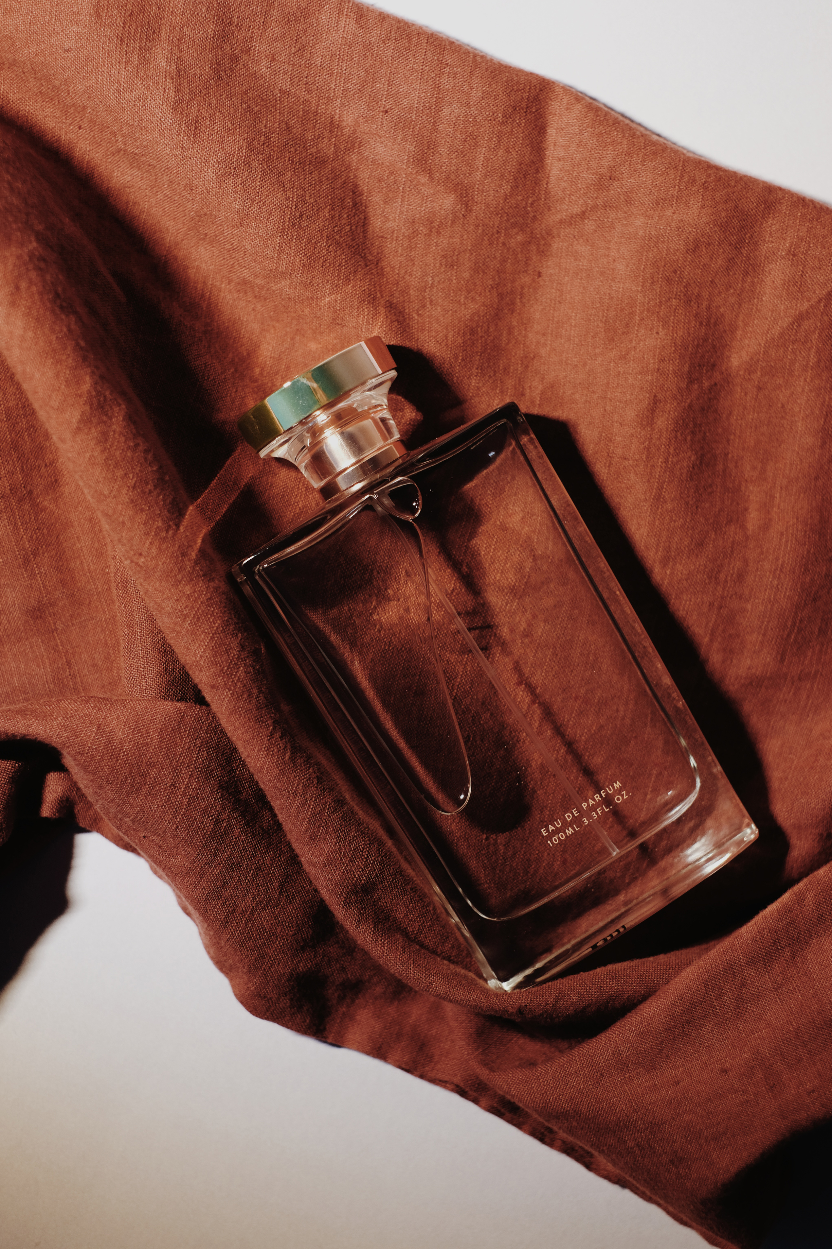
Thank You

